Slide 1


Java Training Day 12

Slide 2
Collection Framework
Exception Handling in Java
Types of Exception
Scenarios where exception may occur
The exception handling in java is one of the powerful mechanism to handle the runtime errors so that normal flow of the application can be maintained.
What is exception handling
Exception Handling is a mechanism to handle runtime errors such as ClassNotFound, IO, SQL, Remote etc.

Slide 3
Advantage of Exception Handling
The core advantage of exception handling is to maintain the normal flow of the application. Exception normally disrupts the normal flow of the application that is why we use exception handling. Let's take a scenario:
statement 1;
statement 2;
statement 3;
statement 4;
statement 5;//exception occurs
statement 6;
statement 7;
statement 8;
statement 9;
statement 10;
Suppose there is 10 statements in your program and there occurs an exception at statement 5, rest of the code will not be executed i.e. statement 6 to 10 will not run. If we perform exception handling, rest of the statement will be executed. That is why we use exception handling in java.

Slide 4
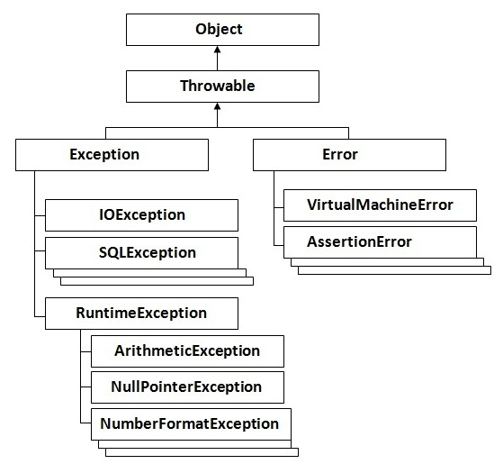
Hierarchy of Java Exception classes

Slide 5
Types of Exception
There are mainly two types of exceptions: checked and unchecked where error is considered as unchecked exception. The sun microsystem says there are three types of exceptions:
Checked Exception
Unchecked Exception
Error
Difference between checked and unchecked exceptions

Slide 6
1) Checked Exception
The classes that extend Throwable class except RuntimeException and Error are known as checked exceptions e.g.IOException, SQLException etc. Checked exceptions are checked at compile-time.
2) Unchecked Exception
The classes that extend RuntimeException are known as unchecked exceptions e.g. ArithmeticException, NullPointerException, ArrayIndexOutOfBoundsException etc. Unchecked exceptions are not checked at compile-time rather they are checked at runtime.
3) Error
Error is irrecoverable e.g. OutOfMemoryError, VirtualMachineError, AssertionError etc.

Slide 7
Common scenarios where exceptions may occur
There are given some scenarios where unchecked exceptions can occur. They are as follows:
1) Scenario where ArithmeticException occurs
If we divide any number by zero, there occurs an ArithmeticException.
int a=50/0;//ArithmeticException
2) Scenario where NullPointerException occurs
If we have null value in any variable, performing any operation by the variable occurs an NullPointerException.
String s=null;
System.out.println(s.length());//NullPointerException

Slide 8
3) Scenario where NumberFormatException occurs
The wrong formatting of any value, may occur NumberFormatException. Suppose I have a string variable that have characters, converting this variable into digit will occur NumberFormatException.
String s="abc";
int i=Integer.parseInt(s);//NumberFormatException
4) Scenario where ArrayIndexOutOfBoundsException occurs
If you are inserting any value in the wrong index, it would result ArrayIndexOutOfBoundsException as shown below:
int a[]=new int[5];
a[10]=50; //ArrayIndexOutOfBoundsException

Slide 9
Java Exception Handling Keywords
There are 5 keywords used in java exception handling.
try
catch
finally
throw
throws

Slide 10
Java try block
Java try block is used to enclose the code that might throw an exception. It must be used within the method.
Java try block must be followed by either catch or finally block.
Syntax of java try-catch
try{
//code that may throw exception
}catch(Exception_class_Name ref){}
Syntax of try-finally block
try{
//code that may throw exception
}finally{}
Java catch block
Java catch block is used to handle the Exception. It must be used after the try block only.

Slide 11
You can use multiple catch block with a single try.
Problem without exception handling
Let's try to understand the problem if we don't use try-catch block.
public class Testtrycatch1{
public static void main(String args[]){
int data=50/0;//may throw exception
System.out.println("rest of the code...");
}
}

Slide 12
Solution by exception handling
Let's see the solution of above problem by java try-catch block.
public class Testtrycatch2{
public static void main(String args[]){
try{
int data=50/0;
}catch(ArithmeticException e){System.out.println(e);}
System.out.println("rest of the code...");
}
}

Slide 13
The JVM firstly checks whether the exception is handled or not. If exception is not handled, JVM provides a default exception handler that performs the following tasks:
Prints out exception description.
Prints the stack trace (Hierarchy of methods where the exception occurred).
Causes the program to terminate.
But if exception is handled by the application programmer, normal flow of the application is maintained i.e. rest of the code is executed.

Slide 14
Assignment :
Try to create file and create folder in one class handle exception
Write a file in one class handle exception
Read a file in one class handle exception

Slide 15
The End
Link references
https://docs.oracle.com/javase/tutorial/
http://docs.oracle.com/javase/tutorial/java/
Poonam Shah
Email id : poonam.shah1985@gmail.com
Phone : 4087681459

